Slide 1
Data Analysis for hr_data.csv
‍Manrui Zhang - mz2807 Yixiong Xu - yx2611
Xi Gu - xg2346 Jiasheng Yu - jy3084 ‍

Slide 2
Catalog
Background
Data Analysis
Data preprocessing
Descriptive analysis
Data visualization
Statistical analysis
Predictive analysis
Conclusion
Future Work
Q&A
Notes:
Background : predict promotion, left
Future work: 加一个tool, 对于失败因素的调整

Slide 3
Background
Data source: https://www.kaggle.com/cezarschroeder/human-resource-analytics-dataset?select=hr_data.csv
Version: It is updated on March 24th, 2019. Version 1
Interests: This dataset contains information related to the employees including their performance(last_evaluation,promotion_last_5years, work_accident, etc), status (left) and evaluation of the company(satisfaction_level). The dataset is complete and detailed, so we want to use it.
Aim: Test whether one employee can meet the requirements of promotion and whether they have already left the company, we perform necessary analysis for the dataset (hr_data.csv).

Slide 4
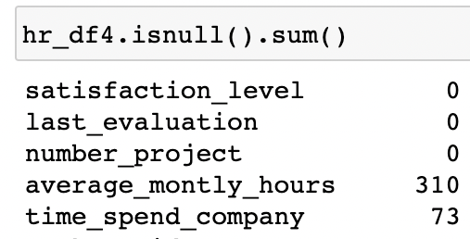
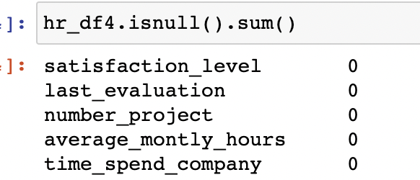
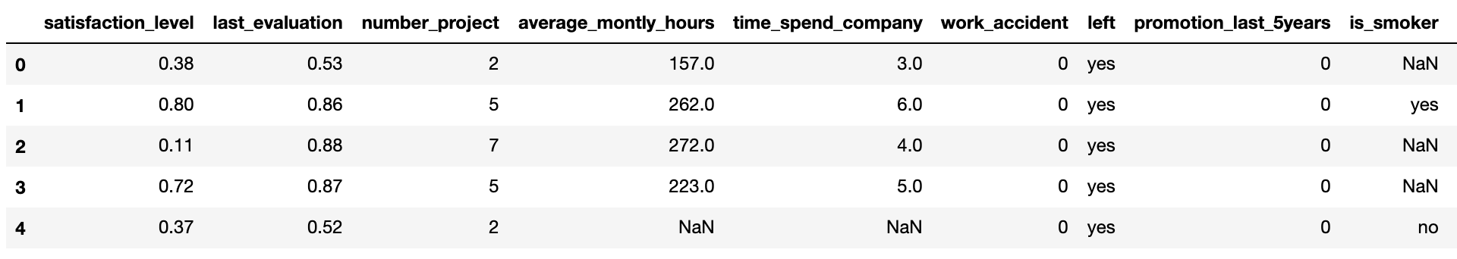
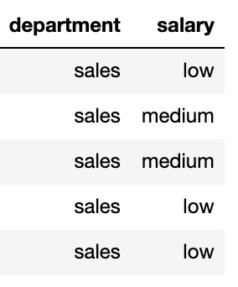
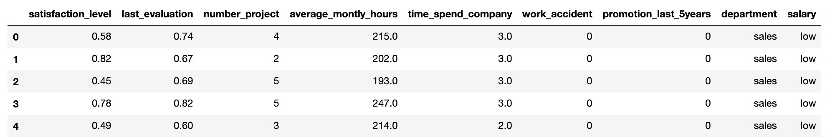
Data Preprocessing
Notes:
We have done basic processing of the data.
Based on our proposal, we removed some unimportant features after the discussion.
Remove the NA values in the feature "average_montly_hours" and "time_spend_company"
Because we only need the information of the employees who are still in the company, we will remove the rows which has the feature "left" equals to yes

Slide 5
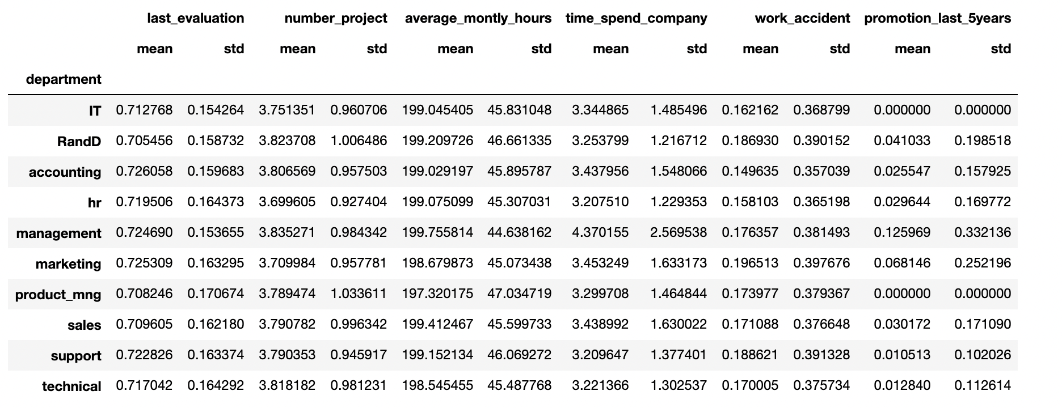
Descriptive analysis
Notes:
We decide to group the dataset by different departments, and mainly focus on the analysis of mean and standard deviation which illustrate a general picture of promotion for various departments.
For the last evaluation, departments of accounting has the highest average value, and R&D has the lowest average value. Both of these two departments have relatively small standard deviation, which means they have stable performance in their own sections.
On the other hands, for work accident(another important feature for promotion), marketing has the highest value in both measurements of mean and standard deviation. Although the average number of work accident for marketing is high (due to its nature of work which requires higher flexibility), the accident may not occur regularly.
We also notice that，the employees in departments of IT and product management are difficult to get promotion, which both departments have none promotion in last 5 years.

Slide 6
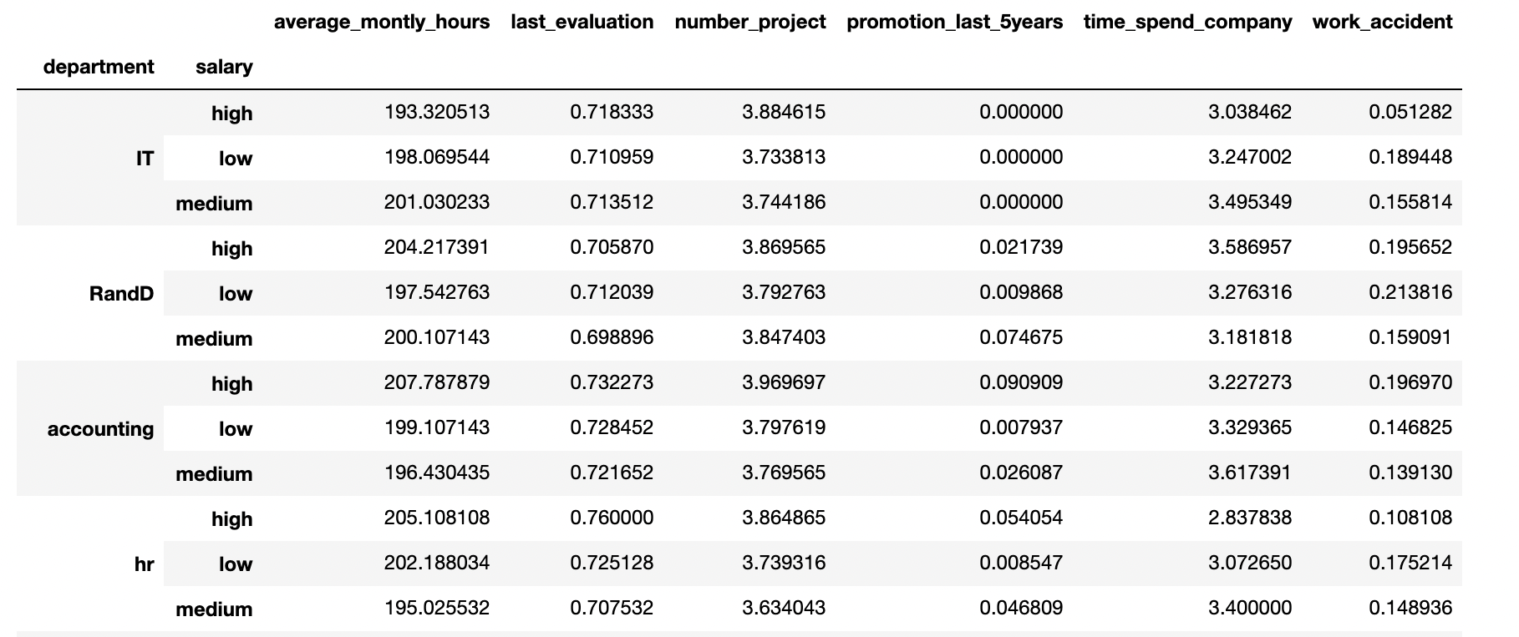
Descriptive analysis
Notes:
Based on the analysis of previous table, we add the salary as additional object to groupby. There are three levels of salary, and the higher level of salary may indicate a higher position of employee in the company. Then, employee with higher position may be more difficult to get promotions. i.e. manager to boss. So we add salary into consideration

Slide 7
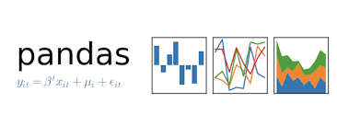
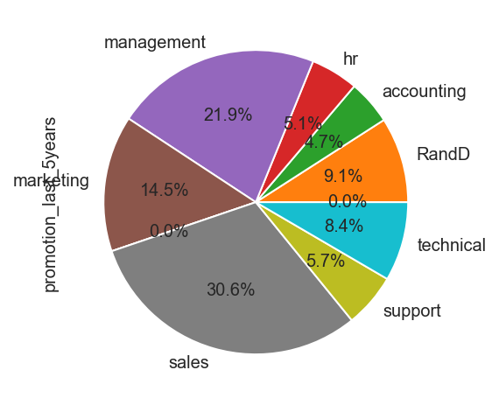
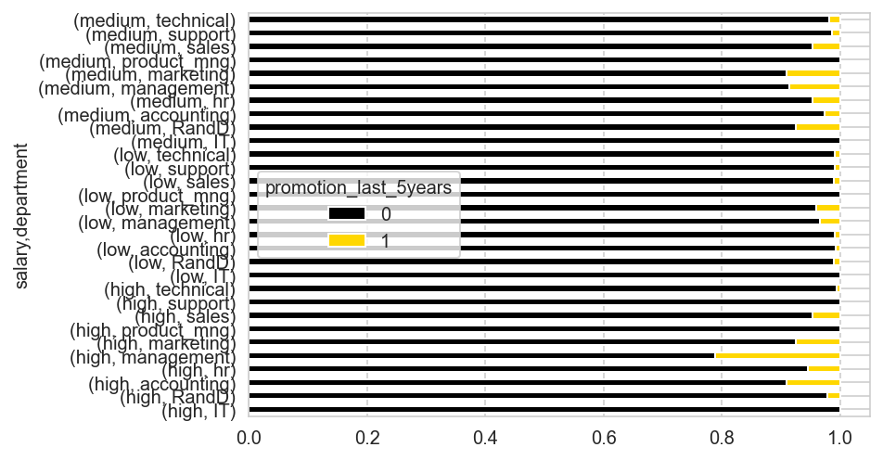
Visualization
Notes:
‘Pandas’ mainly does data processing, providing Data Frame data structure, which fits the table structure of statistical analysis and can be calculated by ‘Numpy’ or other measures.
Pie plot: indicates the promotion sum percentage according to different departments. From the graph, we could notice that the sales department has been promoted the most, while workers in IT and product management have not been promoted in the last five years.
Bar charts are used to draw categorical and numeric columns. It creates bars in the visualization. Combined with ‘pandas’, and then using stacked command to convert the graph, we get the unique bar chart. We can see through observation that employees with different salary levels in the same department have been promoted over the past five years. For instance, employees who work in the management department with the highest salary have the highest percentage of promotions in the stacked bar plot.

Slide 8

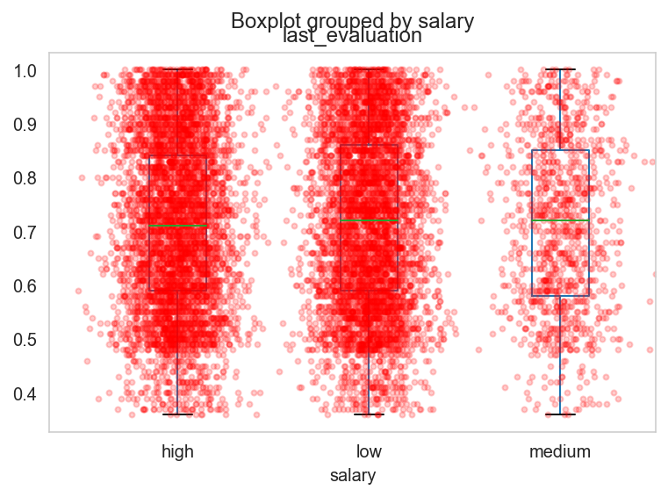
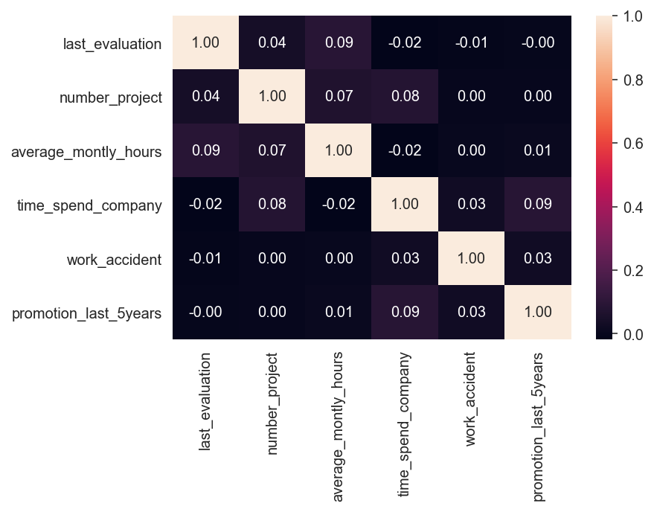
Visualization
Notes:
we notice the positive relationship between salary and last-evaluation from the boxplot.
Five points in the box plot:
Minimum
First Quartile
Median (Second quartile)
Third Quartile
Maximum
In boxplot we found that high and low salary had the largest number of employees. Employees in the medium range are less volatile. From the heatmap, we consider the effectiveness of each feature towards the employee promotion. It can be observed that time_spend_company is an important factor. The longer the one stays at the company, the higher the salary will be.

Slide 9

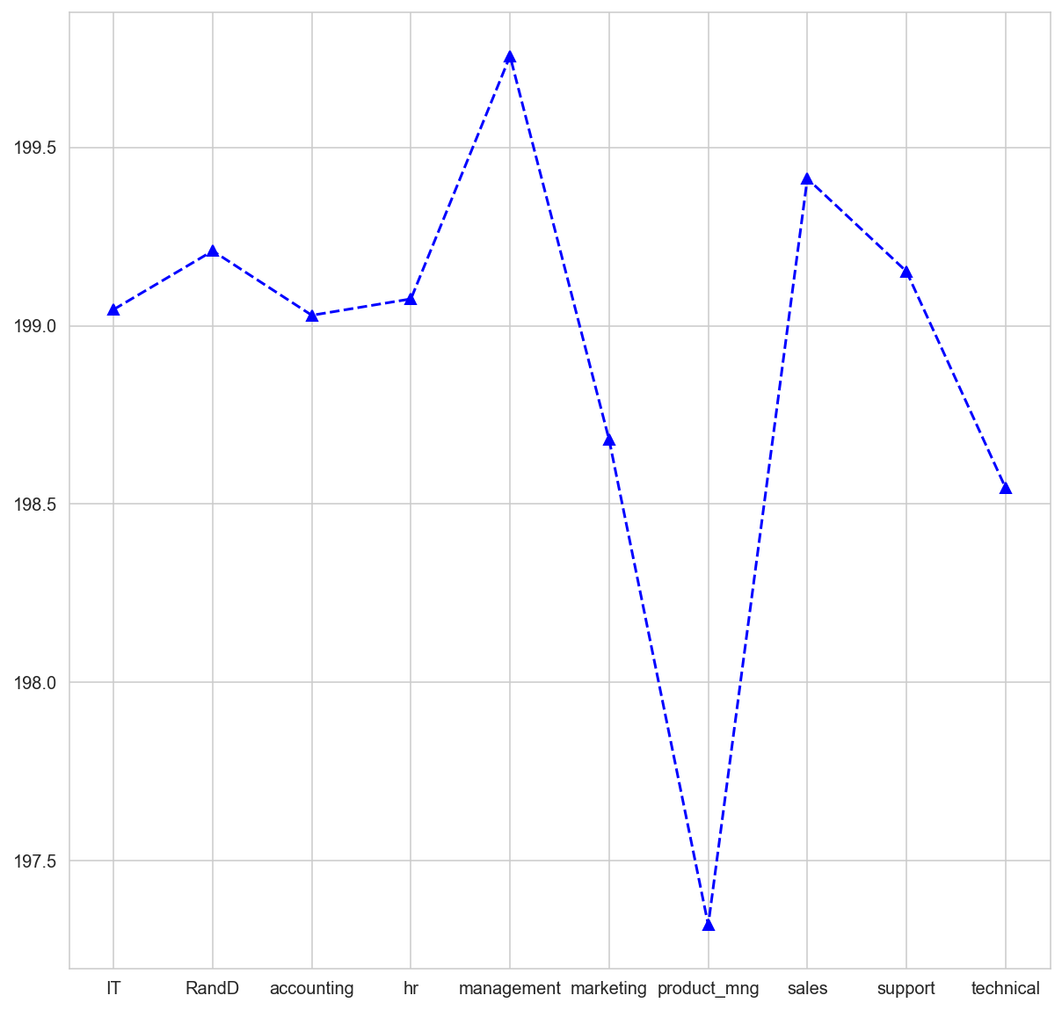
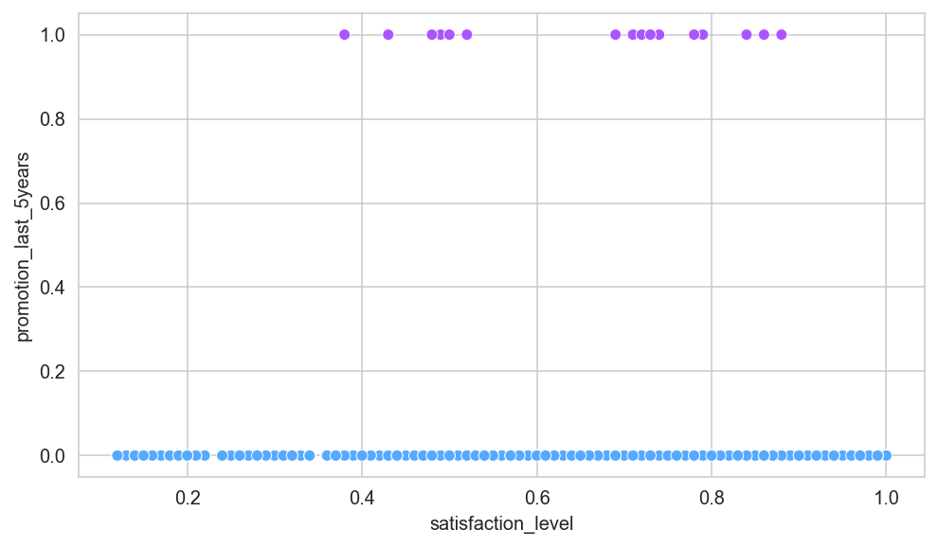
Visualization
Notes:
Seaborn is the data visualization library. Most data analysis needs to identify trends and build models. The seaborn library is the perfect tool to accomplish it.
‘sns.lmplot’ is a straight line that draws a linear regression fit in a scatterplot. It follows a normal minimum diplication, with lines representing the best fit lines.
Line charts are the very common form of expression while using seaborn library. From the graph we notice that the department of management has the highest average_month_hours. But the time fluctuations between the highest and lowest sectors are minimal.
In the scatter plot diagram, the effects of various features on prmotion_last_5years were studied. If we want to get a small p-value regression line, we need more variables.
http://seaborn.pydata.org/citing.html

Slide 10
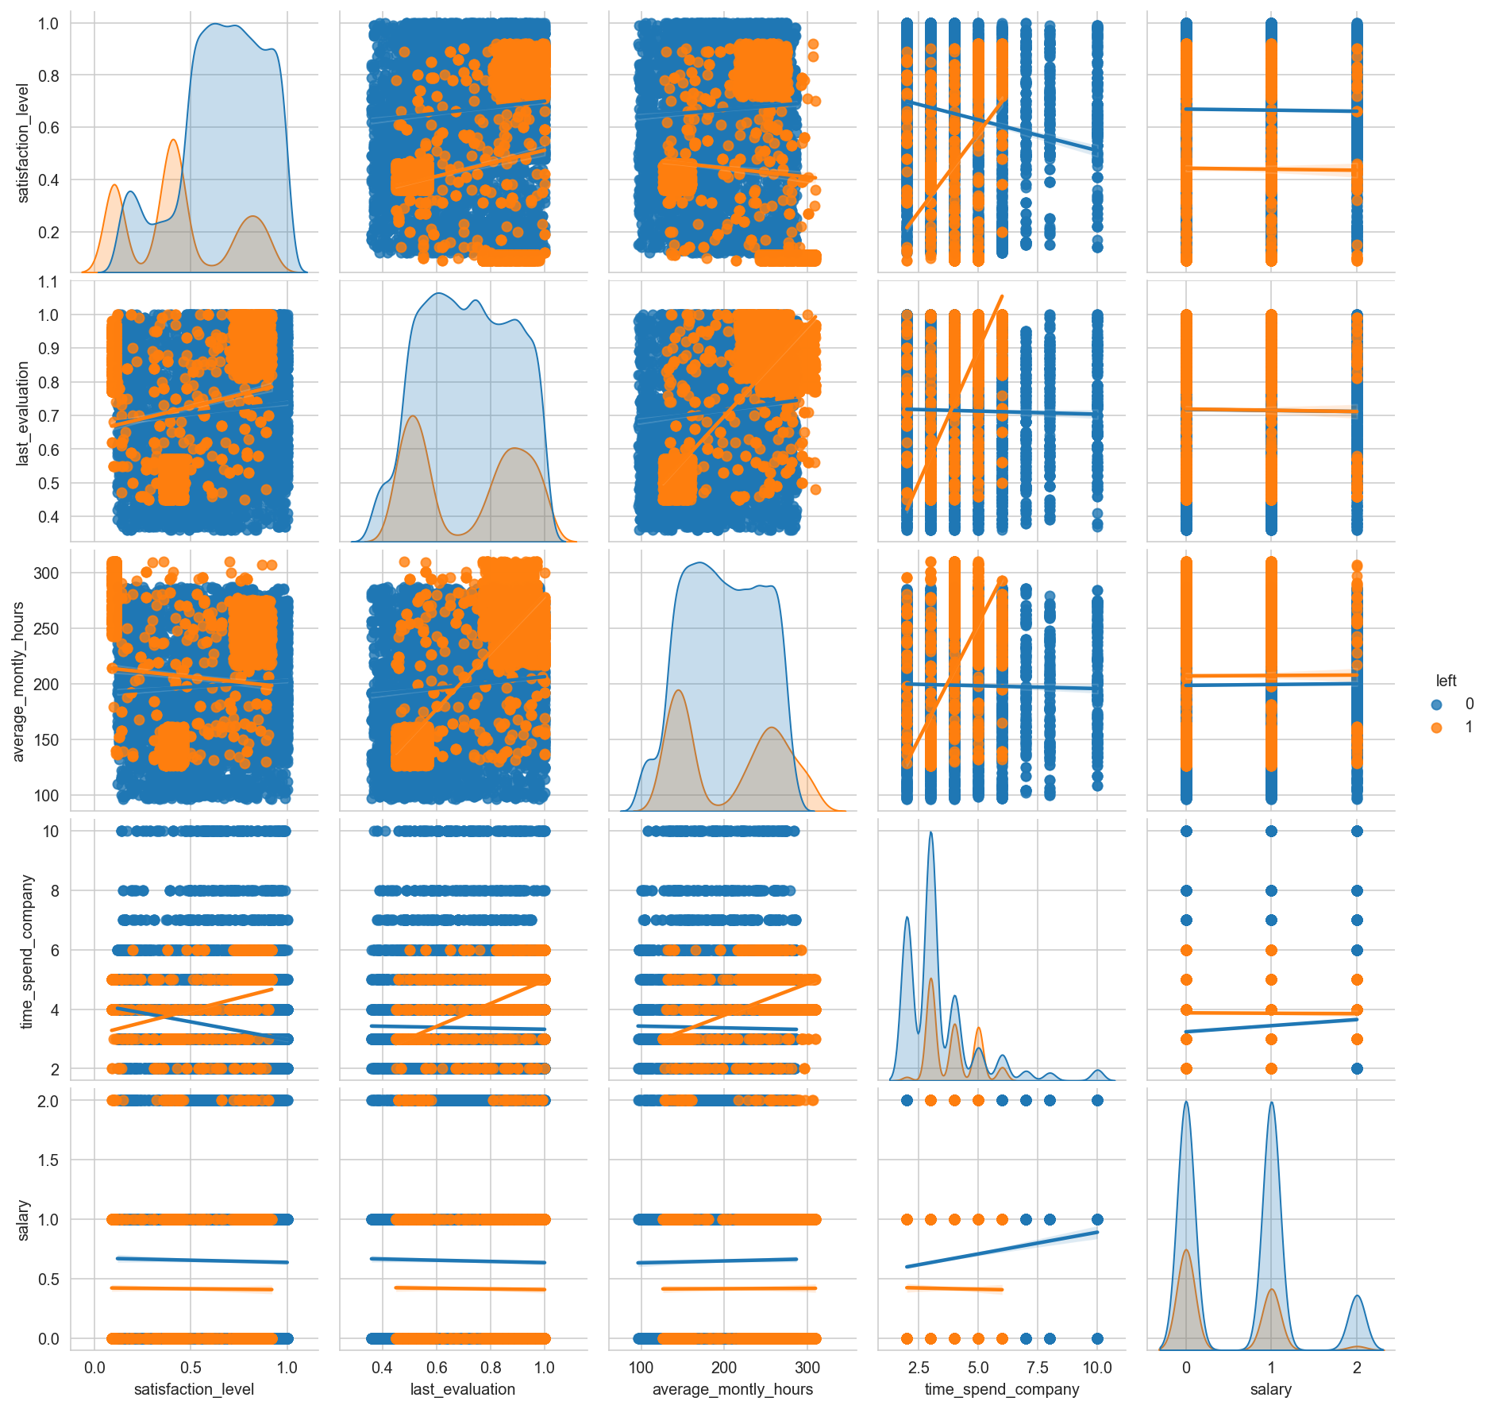
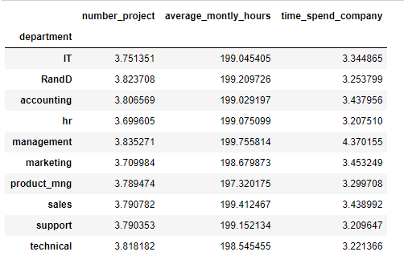
Visualization
Notes:
import seaborn as sns
sns.set_theme(style="white")
The classic pair plot in ‘Seaborn’. It basically draws a pair of relationships between variables and supports the use of "hue" to paint category variables. There is the positive relationships between 'time_spend_company', ‘salary’ and 'average_monthly_hour. And through sns table we can get the positive correlation between number of projects and time spend.

Slide 11
Statistical analysis
One-sample T-Test
Two-sample T-Test: Testing for difference across two groups
Normal Distribution Analysis

Slide 12
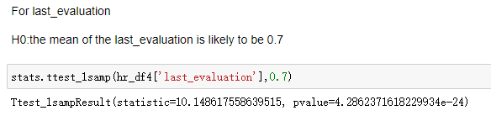
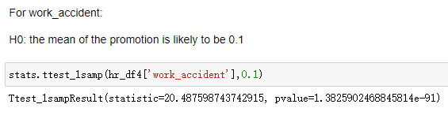
Statistical analysis
One-sample T-Test

Slide 13
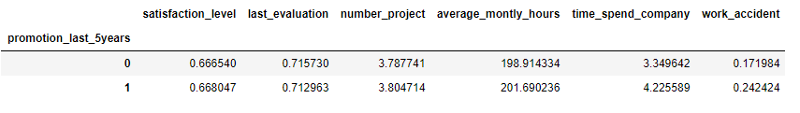
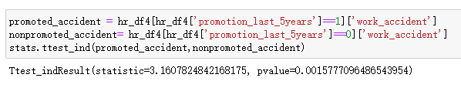
Statistical analysis
Two-sample T-Test

Slide 14
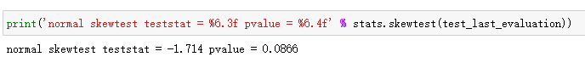
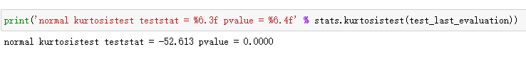
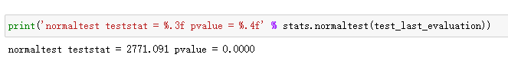
Statistical analysis
Normal Distribution Analysis

Slide 15
Predictive analysis
Multiple Linear Regression model for promotion_last_5years
K-Nearest Neighbor & Decision Tree model for left

Slide 16
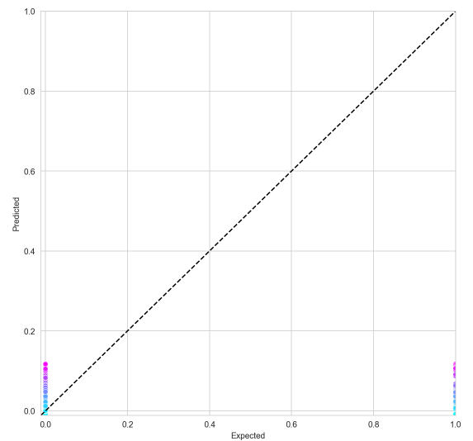
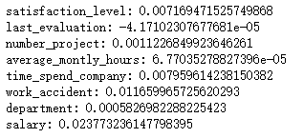
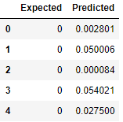
Predictive analysis
Multiple Linear Regression model

Slide 17
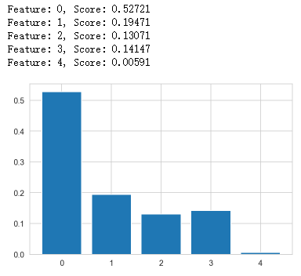
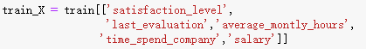
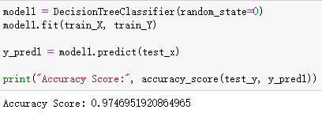
Predictive analysis
Decision Tree model

Slide 18
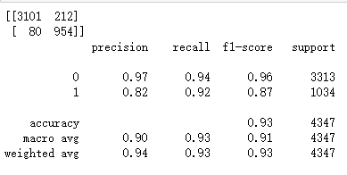
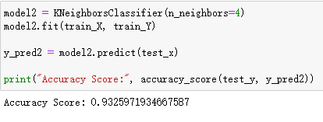
Predictive analysis
K-Nearest Neighbor model

Slide 19
Conclusion
Reflection:
Lack of information about weighted relationship between variables
Subjective elements affect prediction of promotion
Notes:
Although we fail to predict the promotion of employee in this company by using model, we get an accuracy of 97.5% to predict left rate of employees.
Reasons for fail: 1. We infer that there should be weighted relationship between variables, but the author of dataset didn’t provide any explanation about it.
For example, the number of project and average monthly hours should be contributors of last evaluation with different weights.
2. It’s hard to predict promotion since it contains some subjective elements during the process of evaluation, which cannot be presented by
data

Slide 20
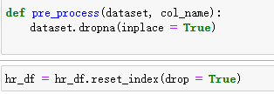
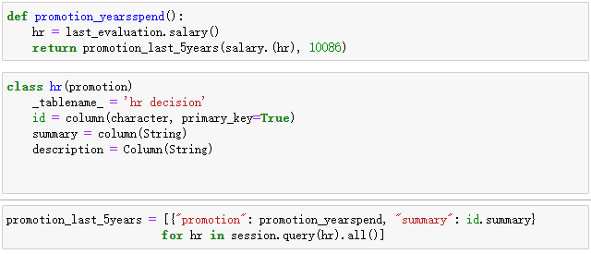
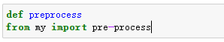
Future Work
：
Notes:
# To remove unnecessary weights.
define what methods can be used to change the state of an object. Indicate what attributes the object can have.

Slide 21
Future Work
We can add more features
We need to choose the frameworks that we build:
An open source problem tracking system
A web application framework
A python interface test
Python's standard module shelve, for storing data.

Slide 22
References
https://www.kaggle.com/cezarschroeder/human-resource-analytics-dataset?select=hr_data.csv
https://numpy.org/doc/stable/user/quickstart.html
https://pandas.pydata.org/docs/getting_started/index.html#getting-started
https://seaborn.pydata.org/
https://matplotlib.org/stable/api/_as_gen/matplotlib.pyplot.html

Slide 23
Q&A

